Slide 1

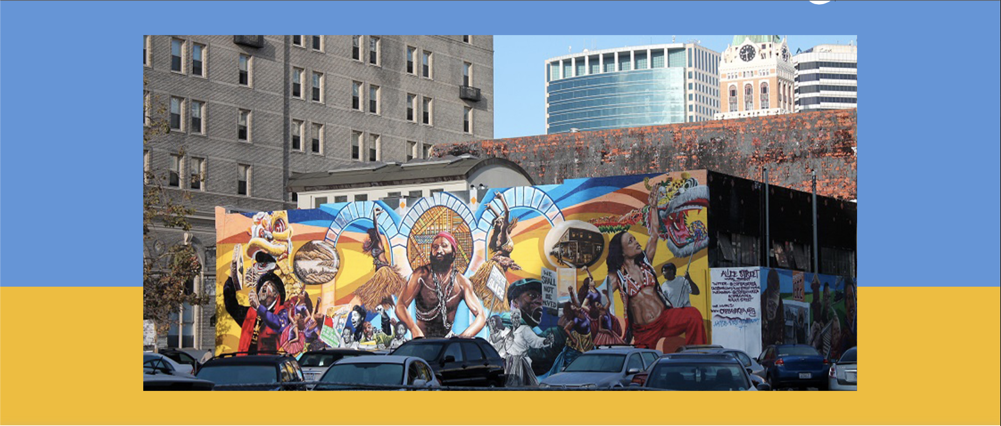
2026 Webinar
October 16, 2026, 10:00 am
Notes:
Values and why it was created

Slide 2

Agenda
Eligibility
Process
Timeline
Q & A

Slide 3
Webinar How-To
If you're having technical issues, please use the Chat feature (only visible to the hosts).
If you have a question, you can submit it through the Q&A feature at any point during the webinar.

Slide 4
Eligibility
Organization located in the East Bay commissioning a Bay Area artist OR
Artist living in the East Bay, a fiscal sponsor is required (does not have to be in the Bay Area)
Must not have been an EBFA awardee during the 2025 calendar year
Commission must support a new work

Slide 5
Full Guidelines and Application
Available online:
https://www.ebcf.org/initiatives/east-bay-fund-for-artists/
https://eastbaycf.smapply.io/prog/east_bay_fund_for_artists

Slide 6
Organization or Artist Application
Should I apply as an individual artist or as an organization?
A few questions to help you answer this question:
  Who is truly leading the work?
  Who is commissioning the project?
  Whose audience or base is being expanded?

Slide 7
Application Checklist
Organizations Artists
Questions/Demographics
Narrative (2 pages)
Project Budget
Project Timeline
Artist(s)’ Statement
Organization Budget (current and previous)
Artist(s)’ Work Sample – with description
Questions/Demographics
Narrative (2 pages)
Project Budget
Project Timeline
Artist(s)’ Work Sample – with description
Presenting venue letter of commitment
Fiscal sponsor letter of commitment
FS Organization Budget (current and previous)

Slide 8
What the panel will be looking for:
Creation of new work and support of individual artists:
  Clear vision with strong artistic practice.
  100% of EBFA Funds and request must be allocated to the lead artist(s) ($5,000 up to $25,000).
  EBFA funds will support up to 75% of the total project cost.
Engagement with community/audience.
Social justice themes in work.
Notes:
Support for the creation of new works by local artists and for East Bay organizations
Engage individual donors
Support diversity of artistic practices and organizations
Provide opportunities for communities of color to experience art that represents their culture and history; social justice themes in the project, or related to social justice issues, campaigns or themes
Support artists and arts organizations that are underrepresented in the arts field
Artist’s statement: how does this fit in with your artistic practice? What inspired you to create this work? Which audiences do you plan to engage?
Lead artist = what does that mean?

Slide 9
Sample Budget
Income |  |  | Expenses
EBFA | $500 |  | Michael Jackson (lead artist) | $500
Individual donors | $500 |  | Janet Jackson (supporting artist) | $200
In-Kind | $50 |  | Recording studio fee | $200
Foundation | $100 |  | Premiere venue fee | $200
Government | $150 |  | Fiscal sponsor fee | $50

Slide 10
Budget template
(Name)
East Bay Fund for Artists
Artist's Budget (year-year)
INCOME/SUPPORT FOR PROJECT | TOTAL | DETAIL
Contributions:
Individual Contributions
In-Kind Donations
Other: |  | (Describe)
Total | $
Government Grants:
xxx
xxx
xxx
Total | $
Foundations:
xxx
xxx
xxx
Total | $
Corporations:
xxx
xxx
xxx
Total | $
Performance Fees:
Ticket Sales
Merchandise
(Item) |  | (Describe)
(Item) |  | (Describe)
Other: |  | (Describe)
Total | $
TOTAL INCOME: | $
(Name)
East Bay Fund for Artists
Artist's Budget (year-year)
EXPENSE | TOTAL | DETAIL
Artist Fees:
Lead Artist Fee
(Name) |  | (Discipline)
Other Artist Fees
(Name) |  | (Discipline)
(Name) |  | (Discipline)
Total | $
Contract Services* (related to project):
xxx |  | (Describe)
xxx |  | (Describe)
xxx |  | (Describe)
Total | $
Rent (related to project):
Office/Studio rent
Performance Rental
Rehearsal
Other: |  | (Describe)
Total | $
Supplies, Equipment, Printing, etc:
Artist Supplies |  | (Describe)
Office Supplies |  | (Describe)
Postage
Printing/Copying
Equipment: Rental
Equipment: Purchase
Equipment: Maintenance/Repair
Total | $
TOTAL EXPENSE: | $

Slide 11
How the Panel Will Score Applications
Clear articulation of the project and how it aligns with the artist’s artistic practice/creative development.
Demonstrated ability to complete project.
Plan to reach/engage your audience.
Strength of social justice themes & issues.
Organizations:
  Rationale for selecting the artist(s)
  Ability to manage the project
Notes:
How aligns with creative artistic practice
Description of why artists was selected and in context of organization’s development
Project management
Budget is realistic/aligned with proposal
Concepts and ideas proposed seem meaningful in the context of the artist’s creative development
Artist’s history of creating and managing projects/ability to complete this project
Soundness and thoroughness of the plan and budget
Plan to reach their audience and appropriateness of presenting venue for this work
Feasibility of plans to make this match
Reviewer’s overall feelings about the proposal
Organizations
Organization’s rationale for selecting the artist(s) to be commissioned
Clear vision of how work fits or departs from regular work of organization and is meaningful in the context of the organization’s development
Organization’s ability to manage the project and offer the artists support for the commission
Feasibility of plans to make this match
Project budget is appropriate and overall organizational budget sound
Artist’s statement
Reviewer’s overall feelings about the proposal

Slide 12
Work Sample
1 or 2 work samples per lead artist
Audio or Video:
  .mp4 or .mov
  No more than 3 minutes long
  Upload to Youtube or Vimeo
Photos
Upload work sample via Survey Monkey Apply
Notes:
What makes a good work sample? Relates to commission; provide context to panel -
Does not need to be live
Instructions for video and audio work samples
Please provide us with a .mp4 or .mov format via Survey Monkey.
We highly encourage applicants to upload video to YouTube. However if you do not use youtube, please provide us with an .mp4 or .mov format
Below are instructions for uploading to youtube (as well as info for first time users)
YouTube accepts videos in the these formats -- .MOV, .MPEG4, .AVI , .WMV, .MPEGPS, .FLV, 3GPP, WebM – and then uses Adobe Flash and HTML5 technology to compress and display the content.
YouTube upload how to:
Go to www.youtube.com, if you do not already have a google account you can easily create one. After you log in, click the “UPLOAD” button at the top of the youtube page, next to the search button. Select the file you would like to upload. From there, you can make your video private (password protected) or public. If you choose to make it private, please provide EBCF with the password in your application.

Slide 13
Timeline
Deadline to apply: October 26, 2026
Panel Decision: Late November
Grants Disbursed: Early December
East Bay Premiere: Within 1 year of receipt of award

Slide 14
Fiscal Sponsorship
A fiscal sponsor is required for all artists and organizations who do not have their own 501c3.
  Does not need to be located in the East Bay.
Fiscal Sponsor Organizations:
  Fractured Atlas - https://www.fracturedatlas.org/site/fiscal/
  SomArts - http://www.somarts.org/programs/fiscal-sponsorship/
  Intersection for the Arts - https://theintersection.org/get-support/fiscal-sponsorship/
  Dancers’ Group - http://dancersgroup.org/aboutsponsorship/
  ProArts - http://www.proartsgallery.org/artistservices/fiscalsponsorship.php
Many local nonprofits provide sponsorship to a smaller number of projects. If you’ve worked closely with a nonprofit organization in the past, ask if they have sponsorship opportunities.
Notes:
Fiscal sponsor will accept ALL contributions, manage all of the acknowledgement letters for tax deduction purposes
Email ebfa@eastbaycf.org and we can send you a full list.

Slide 15
Additional Questions?
Specific, individualized questions?
Contact us!
  ebfa@eastbaycf.org

